Slide 1
CrystalMaker
Materials Science and Engineering
August 26, 2020

Slide 2
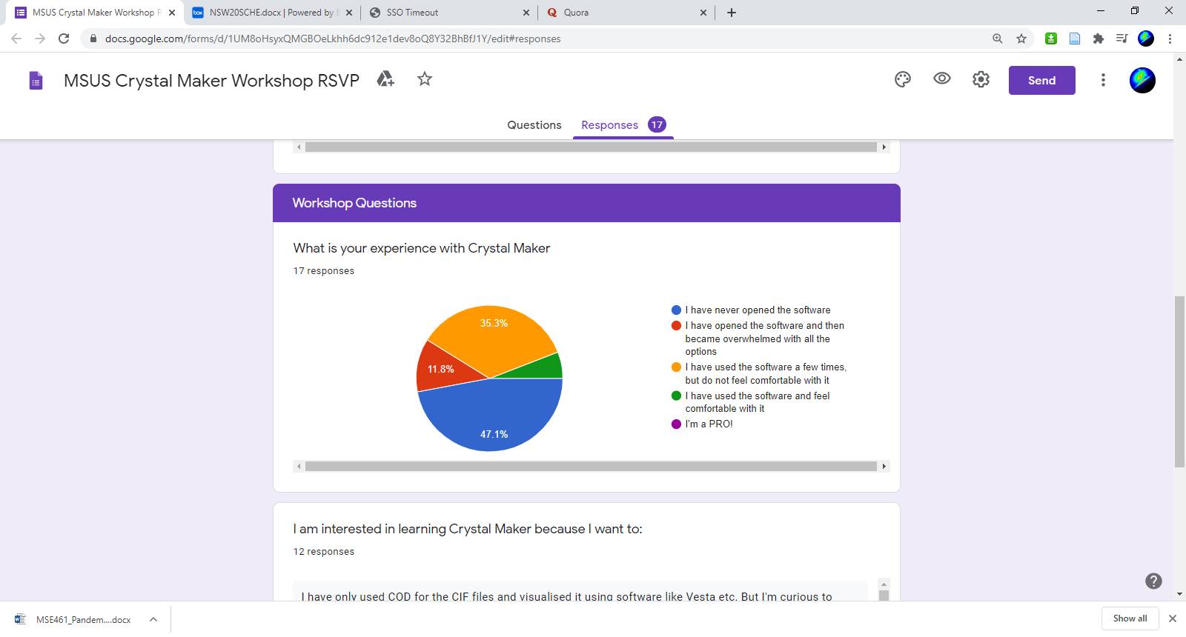
CrystalMaker - Outline
Introduction
Basic Navigation
Building Crystals
Diffraction
Powder simulations
Single crystal simulations
Consulting/Requests
Box Link: https://northwestern.app.box.com/s/s63nlkvdtnax6s22okstcj251ajjk8ay

Slide 3
Better visualization of crystal structures (×6)
Learn more about crystallography (×2)
Make nice figures (×2)
General research tool competency (×2)

Slide 4
CrystalMaker Workshop - Outcomes
Attendees will be able to access CrystalMaker as well as other useful, free software from Northwestern.
Attendees will be able to 1. create crystals from scratch or 2. use crystallographic database to render crystal structures
Attendees will have the ability to investigate structure and symmetry details of any crystal structure they may encounter in classes or research.
Attendees will be able to create publication-quality images.
Attendees will be able to simulate IR, diffraction, and

Slide 5
(Some) Free Competitors
VESTA - https://jp-minerals.org/vesta/en/
Mercury - https://www.ccdc.cam.ac.uk/Community/csd-community/freemercury/
PyXtal* - https://pyxtal.readthedocs.io/en/latest/
J(S)mol - http://jmol.sourceforge.net/
Many more…
Notes:
VESTA – compatibility with DFT data. Electronic structure visualization. Broad import option formats.
Mercury – powerful for visualization and computes simple powder structures.
J(S)mol – Java/JavaScript creation of applets and HTML5 snippets that can be embedded into webpages.
PyXtal – Clean, powerful, opensource Python interface.

Slide 6
CrystalMaker Strengths:
Intuitive GUI
Versatile visualization, rendering, and annotation options
Diffraction calculations
Multistructure/Interface visualization
[Native Mac Program]

Slide 7
CrystalMaker Gallery

Slide 8
CrystalMaker Gallery

Slide 9
Getting Started
Open CrystalMaker
Pick a crystal of interest

Slide 10
Interactivity
Think in orthogonal screen axes.
Crystallographic axes will rotate with crystal.

Slide 11
Interactivity
Mac
Screen x-axis drag: two finger drag up or down on trackpad
Screen y-axis drag: two finger drag left or right on trackpad
Screen z-axis drag: use “rotate” gesture on trackpad
Windows
Screen x-axis drag: turn mouse wheel
Screen y-axis drag: hold alt and turn mouse wheel
Screen z-axis drag: hold shift and move mouse in circular motion

Slide 12
